Slide 1
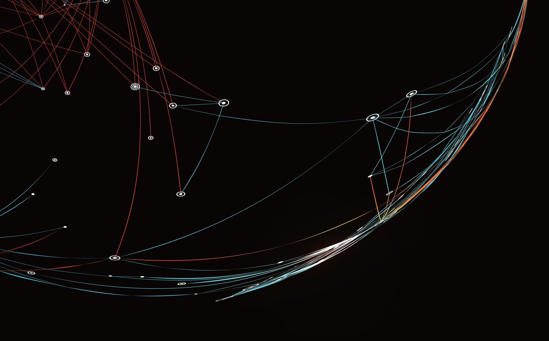
Customer Segmentation and Behavior Prediction
By Jonah Zembower
Notes:
This slideshow is based on the customer segmentation dataset. I am looking for general insights into how we could look at this dataset and discover clusters and how well we could predict future purchases.

Slide 2
Data Preprocessing
-Customer_ID: Unique identifier for the customer
- Age: Customer's age
- Gender: Customer's gender
- Annual_Income: Annual income of the customer
- Total_Purchases: Total number of purchases made by the customer
- Average_Purchase_Value: Average value of purchases
- Product_Category_Most_Purchased: Category of the most purchased products
- Website_Visits_Last_Month: Number of times the customer visited the website in the last month
- Marketing_Emails_Opened: Number of marketing emails opened by the customer
- Hours_Spent_on_Support_Calls: Total hours spent by the customer on support calls
- churn: 1 if they are leaving as a customer, and 0 if they stay
Notes:
Here are the features for each customer. These features include both categorical and numerical values.

Slide 3
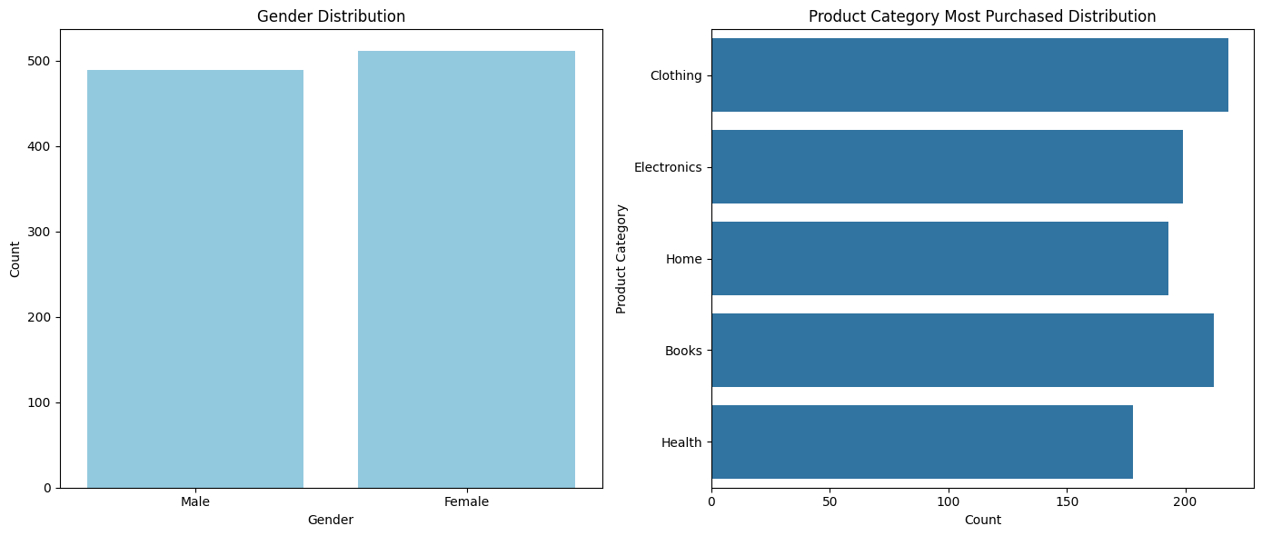
Categorical Features Distributions
Females > Males
Clothing items most purchased
Health items least purchased
Notes:
There appear to be slightly more females than men in the dataset. Also, clothing and books are the most purchased items, yet the health category is the least purchased.

Slide 4
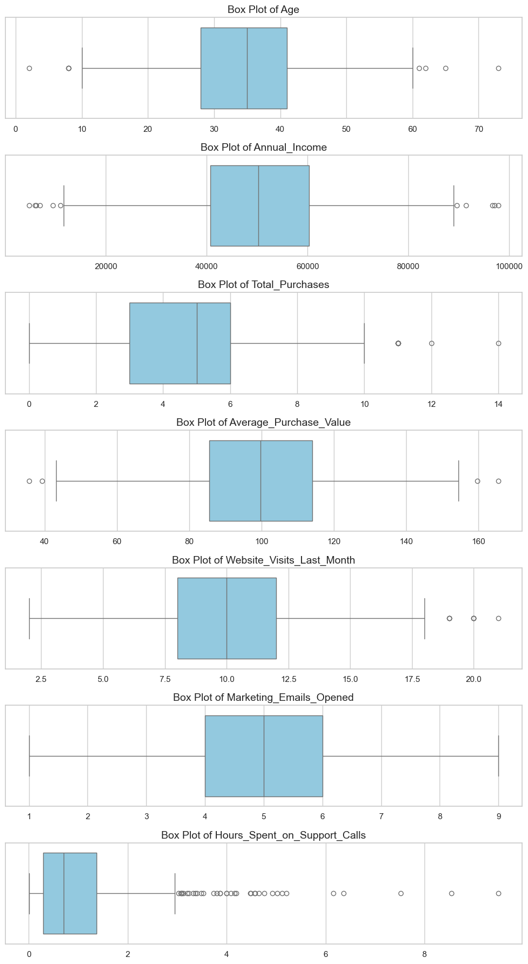
Numerical Features Distributions
Data is mostly evenly spread.
Total purchases and hours spent on support calls are uneven.
Notes:
Here I did a box plot for all of the numeric data. For age, most of the data points are within a reasonable range, though there are some potential outliers for very young ages. Furthermore, it is interesting to point out how diversely spread the purchase value box plot is, as well as annual income. This shows how different purchasing capabilities correlate with differing incomes.

Slide 5
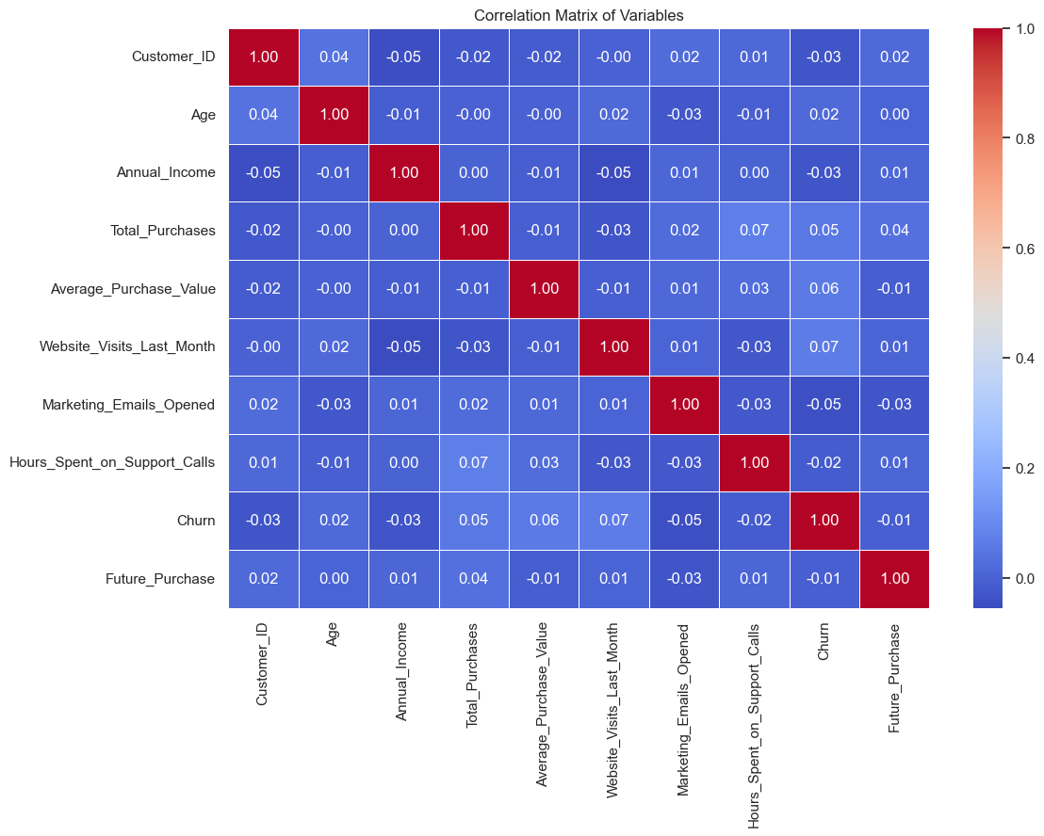
Correlation Matrix of Features
No correlating variables present.
Notes:
Now, I did a correlation matrix to see any potential correlating variables. However, there are no correlations between variables that are cause for removal of any features. Thus, we will leave all the features as they are.

Slide 6
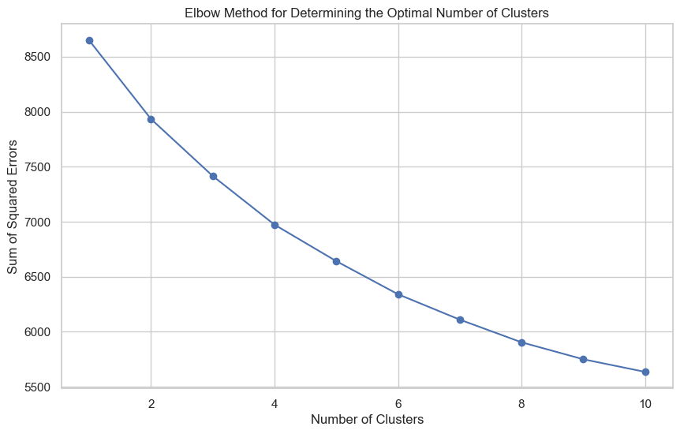
Determining Clusters
Most likely k = 3 or k=4
Notes:
The Elbow Method plot shows how the sum of squared errors (SSE) decreases as the number of clusters increases. It looks like the curve starts to flatten around k=3 or k=4, suggesting that these might be good choices for the number of clusters.
I can start by evaluating both 3 and 4 clusters using K-means, and then check the silhouette scores for these cluster solutions to decide on the best number.

Slide 7
Silhouette Score
- score_3 = 0.0834101672974745
- score_4 = 0.07886511862528289
Notes:
The silhouette scores for the clusters are as follows:
- For k=3 clusters: 0.0834
- For k=4 clusters: 0.0789
These scores are relatively low, indicating that the clusters are not very distinct or well-separated. However, the score is slightly higher for k=3 clusters, suggesting it might be a marginally better configuration for segmenting this particular dataset.

Slide 8
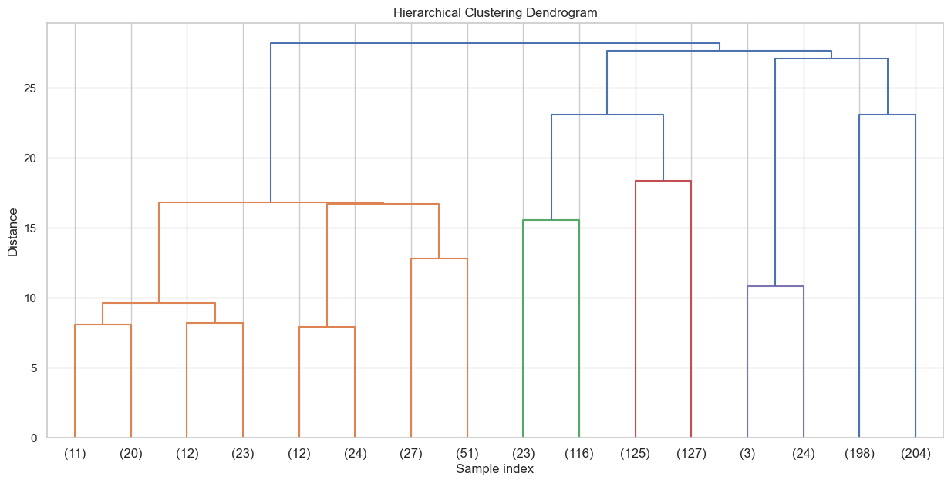
Hierarchical Clustering Dendrogram
Notes:
The dendrogram from hierarchical clustering helps to visualize the data's cluster structure. The height of the merges in the dendrogram indicates the distance at which particular clusters are combined. Short vertical lines indicate clusters that are closely related, while long vertical lines suggest the combination of more distinct groups.
Interpreting the Dendrogram:
- The longest vertical lines without any intersecting horizontal lines suggest natural cluster separations. In this dendrogram, we see a significant merge distance which could imply a good number of clusters. We could consider cutting the dendrogram at various heights to form different numbers of clusters. Let's perform Agglomerative Clustering with 3 and 4 clusters (as suggested by the dendrogram and previous analysis) to evaluate which provides better segmentation based on the silhouette scores.

Slide 9
Silhouette Score for Agglomerative
Score_3 = 0.0406311883047711
Score_4 = 0.047178838583875865
Notes:
The silhouette scores for Agglomerative Clustering are as follows:
- For k=3 clusters: 0.0406
- For k=4 clusters: 0.0472
These scores are lower than those obtained from K-means clustering, indicating that the hierarchical clustering did not result in better segmentation for this dataset. The K-means approach with k=4 provided the highest silhouette score for this method. However, I will proceed to analyze 3 clusters since the values are greater in the other with 3 being the highest.

Slide 10
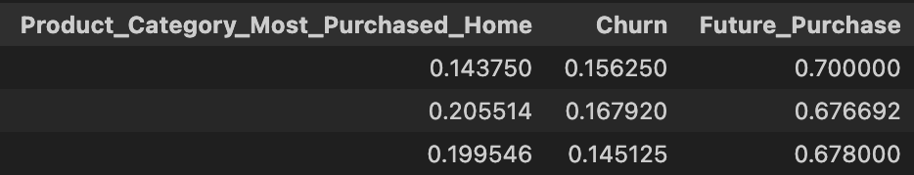
Customer Personas for k=3
Notes:
Now let’s interpret these clusters. First, cluster 0. This cluster could be seen as "Engaged General Shoppers" due to their moderate engagement across purchasing and support but higher support calls indicating potential issues or high engagement with services. Next, cluster 1 appears to be "Affluent, Casual Shoppers" with higher incomes, the highest average purchase values, and a moderate number of purchases and engagements, but fewer website visits and minimal time on support. Lastly, cluster 2 might represent "Economical, Active Browsers" with the lowest average purchase values and total purchases but active website visits, indicating frequent browsing with less commitment to purchases.

Slide 11
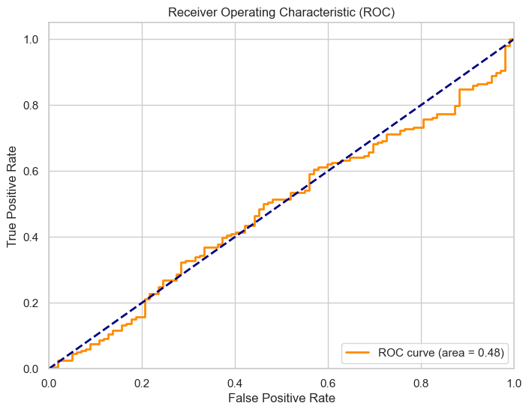
ROC Curve and AUC Score
AUC score = 0.48
Notes:
The ROC curve and the AUC score provide insights into the model's performance. First, the ROC curve plots the true positive rate (TPR) against the false positive rate (FPR) at various threshold settings. The curve gives us a visual idea of the trade-off between sensitivity (TPR) and specificity (1 - FPR). Also, the Area Under the Curve score of approximately 0.48 suggests that the model performs poorly in distinguishing between customers who will make a purchase and those who will not. An AUC score of 0.5 would indicate a model with no discriminatory ability, equivalent to random guessing.
Overall, there are some issues with the model. First, the features used might not be strong predictors for future purchases. Also, logistic regression is a linear model and may not capture complex patterns in the data. Trying more complex models or feature engineering might improve performance.

Slide 12

Neural Network MLP vs. Logistic Regression
The Multi-layer Perceptron (MLP) model's performance metrics are as follows: Accuracy: 56 % Precision: 64.73 % Recall: 73.23 %
The logistic regression model's performance metrics are: Accuracy: 66 % Precision: 66 % Recall: 100 %
Notes:
So, we can see here the logistic regression model has a higher accuracy and precision compared to the MLP model. The recall is notably high for the logistic regression model, indicating it is particularly good at identifying all positive cases (customers who will churn), but this might also suggest a higher false positive rate given its precision is the same as its accuracy.
Given these comparisons, while the MLP model has lower accuracy and precision, its balance between precision and recall might make it more useful depending on the business context, particularly if minimizing false negatives (failing to identify potential churn) is more critical.

Slide 13
Finding Best Configuration using Cross Validation
- Configuration (32, 16): 56.57 % Accuracy
- Configuration (128, 64): 55.71 % Accuracy
- Configuration (64, 32, 16, 8): 58.29 % Accuracy
Notes:
These results indicate that the MLP model with the configuration of (64, 32, 16, 8) performed the best among the tested configurations, though the improvement is modest.

Slide 14
Other Neural Networks
Decision Tree:
Accuracy: 56.7 %
Precision: 67 %
Recall: 67.7 %
SVM
Accuracy: 66 %
Precision: 66 %
Recall: 100 %
Random Forest
Accuracy: 64.7 %
Precision: 66.7 %
Recall: 92.9 %
Gradient Boosting
Accuracy: 62 %
Precision: 65.6 %
Recall: 89.4 %
Notes:
Now, I am looking at other potential Neural Network models that could be used. The SVM model shows the highest accuracy and has an exceptionally high recall, but this may indicate that the model is biased towards predicting the majority class for churn, potentially leading to many false positives. Decision Tree has the lowest accuracy but offers a good balance between precision and recall among the non-SVM models. Both Random Forest and Gradient Boosting have reasonable accuracies with high recall rates, suggesting they are good at identifying true positives but may also be including some false positives.
I decided to look more into the Random Forest model for future analysis potential.

Slide 15
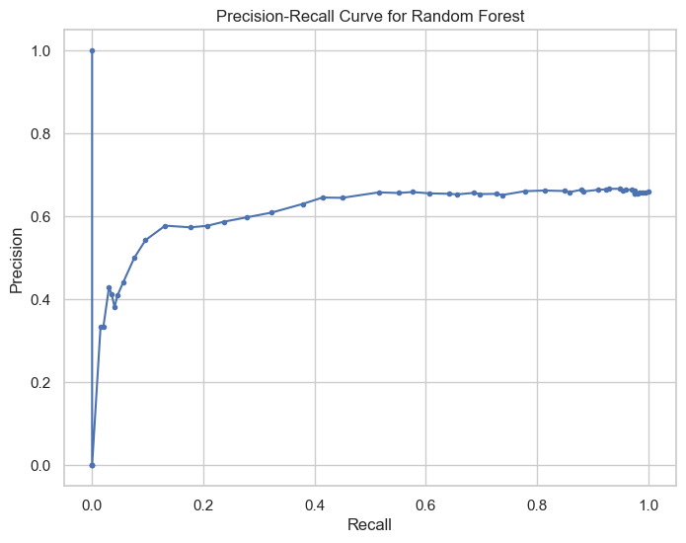
Precision-Recall Curve for Random Forest
Threshold of 0.4 to 0.5 potentially
As recall increases, precision decreases in incline.
Notes:
Here I am looking at the precision recall curve. At the beginning of the curve, the precision starts very high but drops sharply as recall increases. This region is useful if your priority is to minimize false positives. As recall increases from approximately 0.2 to 1.0, the precision stabilizes around 0.6. This is a broad range where the trade-off between recall and precision might be acceptable depending on your business needs.
Lastly, threshold adjustment can be estimated based on the elbow of the curve at about a recall of 0.4 to 0.5. From there, we can see the precision is also relatively high.

Slide 16
Testing Threshold 0.4
Accuracy: 64.33 %
Precision: 65.42 %
Recall: 97.47 %
Notes:
Accuracy indicates the overall percentage of correct predictions (both true positives and true negatives). The accuracy is moderately high, suggesting that the model is effective in predicting the outcomes overall, though there is still a considerable proportion of misclassifications. Precision measures the accuracy of the positive predictions. In this case, when the model predicts churn, it is correct approximately 65.42% of the time. This is a reasonable rate, but it also implies that around 34.58% of the predicted churn cases are false positives. Recall, or sensitivity, measures the model's ability to identify all actual positives. The extremely high recall indicates that the model is excellent at detecting potential churns, missing very few actual churn cases (only about 2.53%). This is crucial if the cost associated with failing to identify a customer who might churn is high (e.g., loss of revenue, deterioration of customer relationship).

Slide 17

Random Forest Thresholds Testing
Tested between 0.3 and 0.5:
Found 0.3 is the best
F1 score: 0.795
New Predictions:
Accuracy: 66 %
Precision: 66 %
Recall: 100 %
Notes:
I now looked at assessing all of the potential thresholds for the Random Forest model. The F1 score is the harmonic mean of precision and recall, making it a more comprehensive measure of a model's accuracy, especially when the costs of false positives and false negatives are significant but different. An F1 score of 0.795 suggests that the model balances the identification of churn (recall) and the accuracy of those identifications (precision) quite well, particularly for a decision threshold of 0.3.
I then found new predictions that were slightly better due to the threshold change.

Slide 18
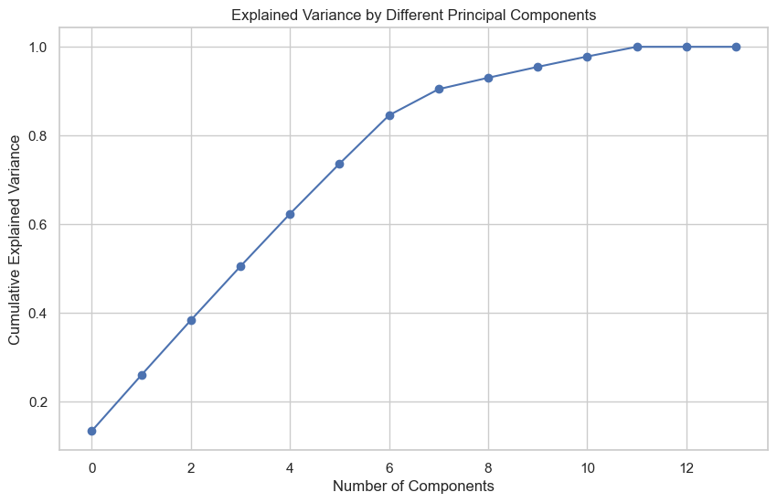
PCA Analysis
About 73.6% variance by the 6th component
After 8th component the variance tapers off
Notes:
The variance accumulates rapidly with the first few components, reaching about 73.6% by the 6th component. After the 8th component, the gain in explained variance significantly tapers off, reaching around 90.4%. By the 12th component, the variance explained is 100%, but the additional gain after the 10th component is minimal. Based on the elbow-like bend around the 6th to 8th components and considering the diminishing returns beyond these points, a practical choice could be 6 components for a more compact model while retaining approximately 73.6% of the variance or 8 components to capture over 90% of the variance for more detailed analysis, which might be more useful if slight nuances in the data are critical for the analysis or predictive modeling.

Slide 19
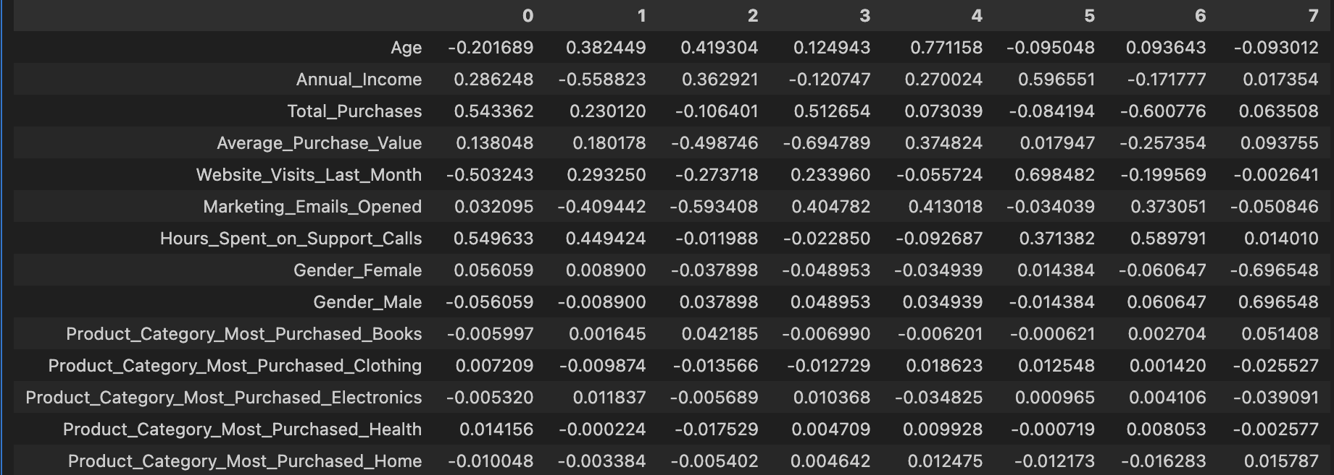
Loading Scores
Notes:
I decided to do 8 loading scores. I noticed some distinct positive or negative weights on attributes in Principal component one and two. I decided to move on to look at analysis of these components.

Slide 20
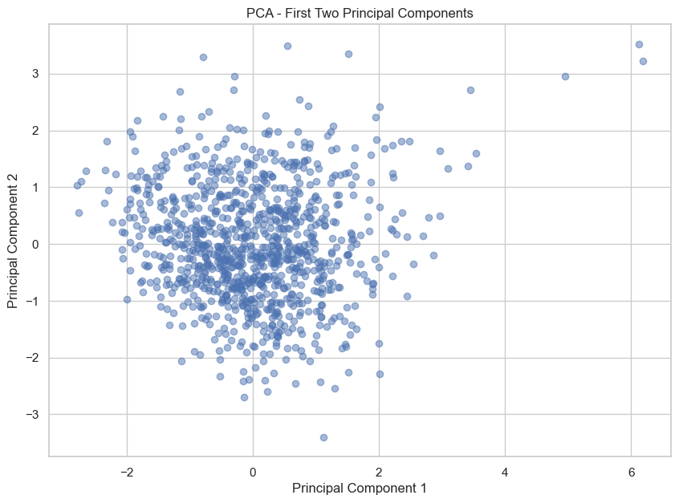
First Two Principle Components
Dense cluster around a similar event
Notes:
The plot shows a dense cluster around the center, suggesting that most data points (customers) share similar characteristics to a certain extent when viewed in the context of these two principal components. There are several outliers or points spread further away from the center. These could represent customers with more distinct or less common behaviors.
Given the loading analysis for Principal Component One, this component is influenced heavily by Total Purchases and Hours Spent on Support Calls, positively, and Website Visits Last Month, negatively. The spread along this axis might distinguish between customers who make many purchases and need more support versus those who are frequent website visitors but may not purchase as much. For Principal Component Two, it is primarily influenced by Age, positively, and Annual Income, negatively. The vertical spread suggests variability in customer demographics, particularly age and income levels.
Overall, the central clustering indicates a large group of customers with average behaviors according to the captured principal components.
- Customers towards the right may be your more engaged or high-maintenance customers, potentially requiring targeted marketing strategies or specific customer service approaches.
- Those further up or down might represent different age groups or economic segments, which could be targeted with age-appropriate or income-sensitive products and services.

Slide 21
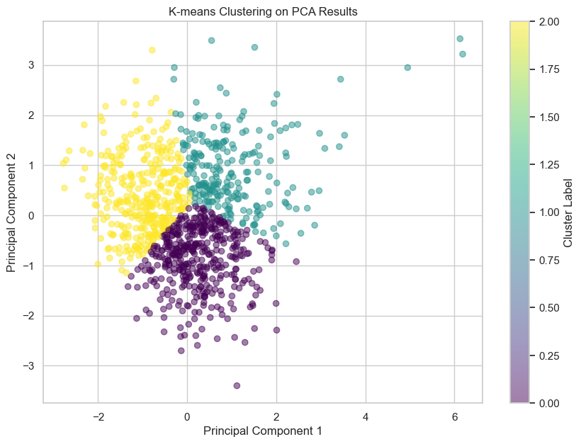
K Means Clustering on PCA
Notes:
The clustering has divided the dataset into three distinct groups, each marked by different colors in the plot:
The purple cluster, primarily concentrated around the center, suggesting these customers might have average values on the underlying variables represented by the first two principal components. The yellow cluster is positioned further along the positive direction of Principal Component 1, indicating these customers could have higher scores on features contributing positively to this component, such as more frequent purchases or higher support needs. The cyan cluster is more spread out, particularly along both principal components, indicating variability in their scores and possibly representing a more diverse group in terms of the underlying behaviors.

Slide 22
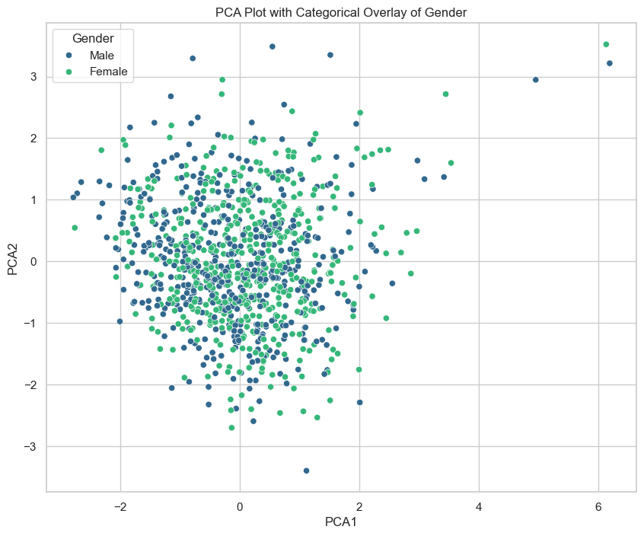
PCA Plot with Gender
Notes:
There doesn’t appear to be any pattern for the clustering of Gender. So, I will now analyze how it looks for the products that are purchased.

Slide 23
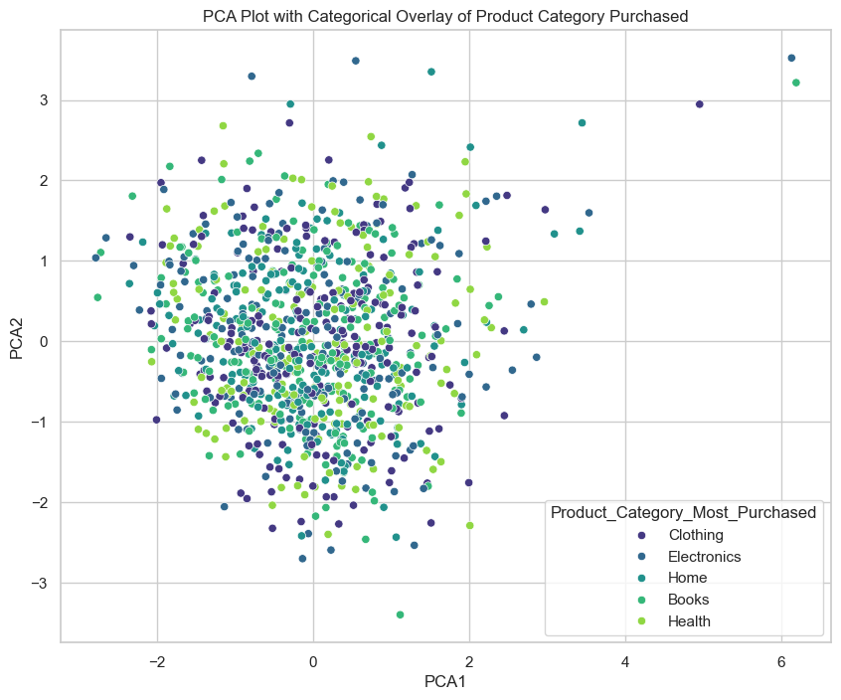
PCA Plot with Product Category Purchased
Notes:
For this plot, all categories appear to have a substantial overlap in the central cluster, indicating that customers purchasing different types of products share similar traits or behaviors in terms of the components analyzed. There are some sparse separations where certain categories like Health and Electronics show slightly more distinct distributions, possibly indicating some unique characteristics of these customer groups, but these are not strongly pronounced.
Overall, the overlap suggests that across different product categories, customer behaviors (as captured by PCA) are fairly homogeneous. This could imply that marketing strategies focusing purely on behavioral segmentation may not need to differentiate strongly between product categories.

Slide 24
Conclusion
Variables were discernibly distinct from each other in correlation.
The variables did show a lot of overlap though in principal component analysis.
Gender
Product Category Most Purchased
Overall, focus on annual income, total purchases, and website visits for future analysis.
Notes:
The variables of this dataset appeared to have no correlations between each other, yet there was a lot of overlap in the connections. I was unable to find common distinctions in the different clusters for the customers. This could show only certain advertising features should be considered rather than others. Overall, there are multiple variables that showed potential meaning in the clusters. This includes annual income, total purchases, and website visits. There are more that can be analyzed and found in the full report.

Slide 25
Image Analysis of Avengers
Given images of various Marvel Avengers
Captain America
Thor
Hawkeye
Iron Man
Black Widow
Goal is to train a neural network
Notes:
For the next part of the presentation, I am going to perform image analysis on faces that are considered both positive and negative for each character and train the neural network to read future images as being positive or negative.

Slide 26
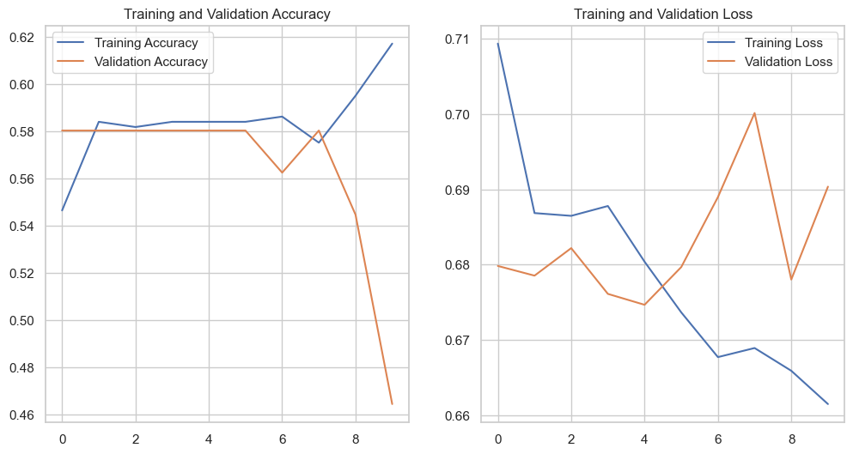
Initial Training Set Results
Notes:
The training accuracy begins at about 0.54 but then as it progresses, it improves to about 0.62, However, the validation accuracy went down as the training accuracy increased. This is indicative of potential overfitting. This is since the model performs much better on training data compared to validation data. Lastly, we can see there are also improvements in the loss showcasing the model is learning.

Slide 27
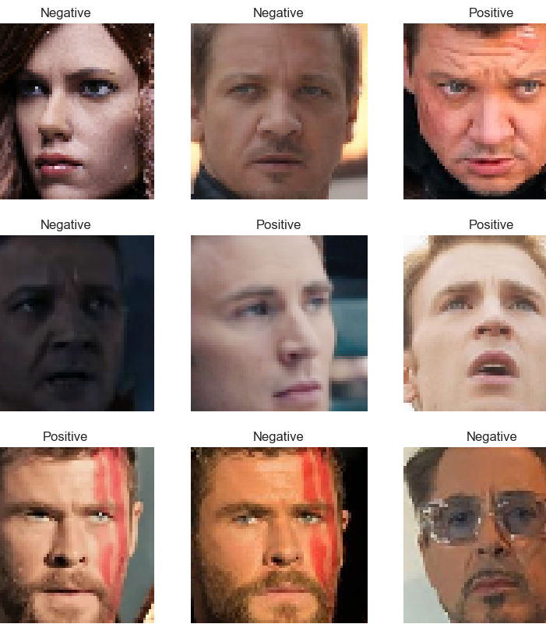
Test Set Results
Notes:
These images were relatively correct from what they were supposed to be as positive referring to smiling and happy and negative as not happy. The top right and bottom left seemed to be incorrect, but the other images were correct out of 9. This is accurate about 70% here and follows with the general accuracy rate seen from the evaluation of the model. Therefore, further feature analysis could be used in the future to develop a more accurate model.

